Slide 1

Training Models

Slide 2
Recap
So far we have learned how to get things done
Without knowing anything about
What’s under the hood
However understanding how things work can help us in
Choosing the appropriate model
Right training algorithm to use
Good set of hyperparameters
Debugging issues and
Perform error analysis

Slide 3
Training Models
In this session
We will learn about internals of how models are trained
We’ll cover various algorithms of Gradient Descent like
Batch Gradient Descent
Stochastic Gradient Descent
Mini-batch Gradient Descent
Later we will learn different ways of regularizing linear models
Ridge Regression
Lasso Regression
Elastic Net

Slide 4
Training Models
Then we will learn about logistic regression
Most of the topics discussed in this chapter will also be essential in
Understanding
Building and
Training neural networks

Slide 5
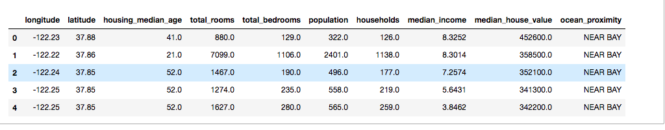
Notations
Let’s understand the notations used in this course
These notations will help in understanding the mathematical equations
Let’s take the example of housing dataset in end-to-end project for understanding notations

Slide 6
Notations
m is the number of instances in the training dataset
For example
If we have 2000 districts in our training dataset
Then m = 2000

Slide 7
Notations
x^{(i)} is a vector of all the feature values (excluding the label)
Of the i^{th} instance in the dataset and
y^{(i)} is its label (the desired output value for that instance)

Slide 8
Notations
For example, if the first district in the dataset has below values
longitude –118.29°
latitude - 33.91°
inhabitants - 1,416
median income - $38,372
median house value - $156,400
Then x⁽¹⁾ and y⁽¹⁾ will be

Slide 9
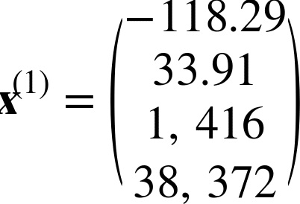
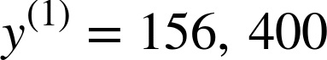
Notations
For example, if the first district in the dataset has below values
longitude –118.29°
latitude - 33.91°
inhabitants - 1,416
median income - $38,372
median house value - $156,400

Slide 10
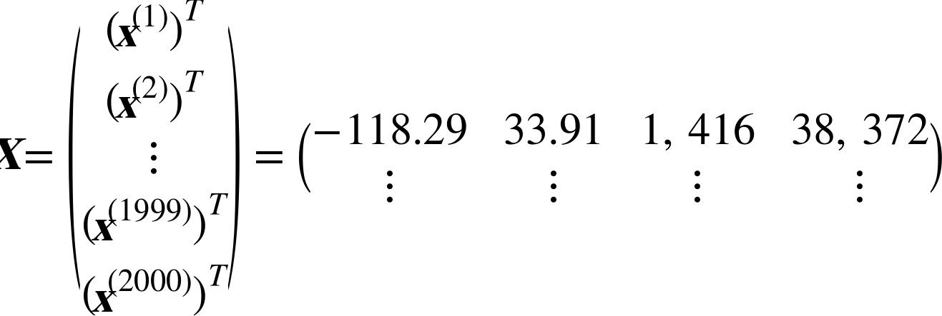
Notations
X is a matrix
Contains all the feature values (excluding labels) of all instances in the dataset
There is one row per instance and
the i^{th} row is equal to the transpose of x^{(i)}, noted (x^{(i)})^{T}

Slide 11
Notations
h is system’s prediction function
Also called as hypothesis
When we train a model using instance feature vector x^{(i)}
We get predicted value ŷ^{(i)} = h(x^{(i)}) for that instance
ŷ is pronounced “y-hat”

Slide 12
Notations
For example if model predicts that the
Median housing price in the first district is $158,400
Then ŷ⁽¹⁾ = h(x⁽¹⁾) = 158,400
The prediction error for this district is ŷ⁽¹⁾ – y⁽¹⁾ = 2,000
RMSE(X, h) is the cost function
Measured on the set of examples using hypothesis h

Slide 13
Notations
In general we will use
Lowercase italic font for
Scalar values such as m or y^{(i)} and
Function names such as h
Lowercase bold font for vectors
Such as x^{(i)}
Uppercase bold font for matrices
Such as X

Slide 14
Training Models
Linear Regression

Slide 15
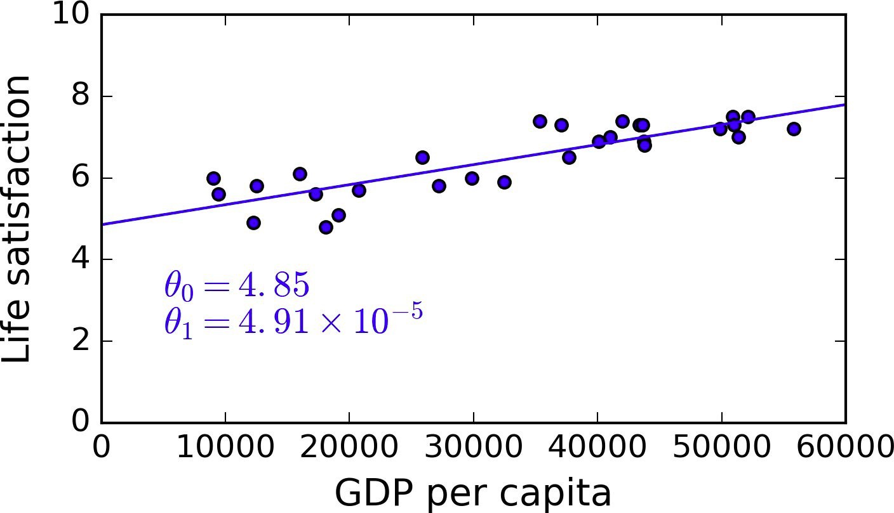
Linear Regression
Let’s look at the simple linear regression model of
Life satisfaction vs GDP per capita

Slide 16
Linear Regression
θ₀ and θ₁ are the model’s parameters
Let’s say our model has learned the parameters θ₀ and θ₁ as
θ₀ = 4.85
θ₁ = 4.91 * 10 ⁻⁵
Then the final equation becomes
life_statisfaction = 4.85 + 4.91 * 10⁻⁵ * GDP_per_capita
θ₀
θ₁

Slide 17
Linear Regression
Question
What does this equation mean?

Slide 18
Overview
We can find the life_satisfaction value for an unknown GDP per capita
Find the live_satisfaction value for GDP per capita of 33,000
By plugging in the value in the equation
life_statisfaction = 4.85 + 4.91 * 10 ⁻⁵ * 33000
θ₀
θ₁
GDP per capita

Slide 19
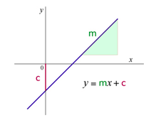
Linear Regression
General Equation of Line
Equation of line y = mx + c
Did you notice that previous equation is an equation of a line
Slope (θ₁)
y intercept (θ₀)

Slide 20
Question
What if y-intercept (θ₀) is zero?

Slide 21
Linear Regression
Answer
Y
y = mx
X
O(0, 0) - Origin
If y-intercept is zero then the line will pass through origin i.e (0, 0)

Slide 22
Linear Regression
Let’s go back to end-to-end project
If we build the model for predicting house prices using below attributes
longitude
latitude
inhabitants and
median_income

Slide 23
Linear Regression
General Equation of Linear Regression
Then our trained model will be like below equation
Predicted_house_price = θ₀ + θ₁ * longitude + θ₂ * latitude +
θ₃ * inhabitants + θ₄ * median_income
Where
θ₀ - Constant. Also called as bias or intercept term
θ₁ - Weight of longitude feature
θ₂ - Weight of latitude feature
θ₃ - Weight of inhabitants feature
θ₄ - Weight of median_income feature

Slide 24
Linear Regression
General Equation of Linear Regression
ŷ is the predicted value
n is the number of features
x_{i} is the i^{th} feature value
θ₀ is constant. Also known as bias or intercept term
θ_{j} is the j^{th} model parameter (including the bias term θ₀ and the feature weights θ₁, θ₂, ⋯, θ_{n}).

Slide 25
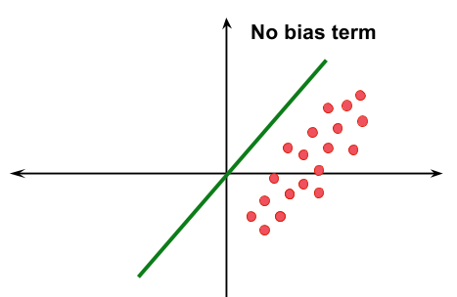
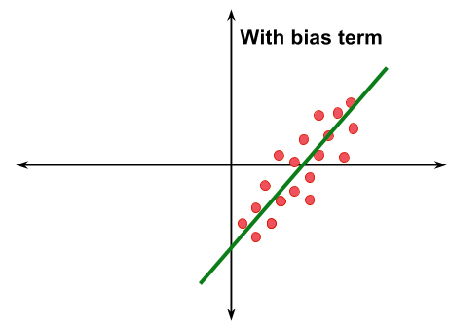
Linear Regression
Why bias or intercept term?
Without the bias term our solution may go through the origin
Let’s say if all the features are zero
Then predicted value will also be zero
However, that may not be the answer the training data suggests

Slide 26
Linear Regression
Why bias or intercept term?
Bias term is a constant
Does not depends on any feature
Adding a bias weight allows the algorithm to
Easily fit data that does not pass through origin

Slide 27
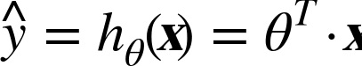
Linear Regression
General Equation of Linear Regression - Vector Form
Where
θ is the model’s parameter vector
Containing the bias term θ₀ and the feature weights θ₁ to θ_{n}
θ^{T} is the transpose of θ (a row vector instead of a column vector)
θ^{T} = (θ₁, θ₂, θ₃ …………….. θ_{n})

Slide 28
Linear Regression
General Equation of Linear Regression - Vector Form
Where
x is the instance’s feature vector
Containing x₀ to x_{n}
With x₀ always equal to 1
x = ( 1,
longitude,
Lattitude,
------
)

Slide 29
Linear Regression
General Equation of Linear Regression - Vector Form
Where
θ^{T} · x is the dot product of θ^{T} and x
h_{θ} is the hypothesis function, using the model parameters θ
h_{θ} fits the model and
Calculates weights

Slide 30
Linear Regression
General Equation of Linear Regression - Vector Form
Now we have our linear regression model equation
But How do we train it?

Slide 31
Linear Regression
How Do We Train the Model?
Training a model means setting its parameters
So that the model best fits the training set
For this purpose, we first need a measure of
How well (or poorly) the model fits the training data
As we have seen in end-to-end project
Common performance measure of regression model is
RMSE - Root Mean Square Error or
MSE - Mean Squared Error

Slide 32
Linear Regression
How Do We Train the Model?
We’ll use MSE - Mean Square Error for training the model in this session

Slide 33
Linear Regression
How Do We Train the Model?
We’ll use MSE - Mean Square Error for training the model in this session
Why MSE?

Slide 34
Linear Regression
How Do We Train the Model?
It is simpler to minimize MSE than RMSE
Function which minimizes MSE also minimizes its square root so it doesn't matter to use MSE or RMSE

Slide 35
Linear Regression
Let’s have a quick recap of MSE

Slide 36
Linear Regression
Select a Performance Measure - Mean Square Error
Let’s say we want to predict house value based on house area in square feet
We will use univariate linear regression
Since there is only one feature house area

Slide 37
Linear Regression
House Value vs House Area - Actual Data
House Value (In $)
House Area (In Sq ft)

Slide 38
Linear Regression
Fit a Line
House Value = W0 + W1 * House Area
House Value (In $)
House Area (In Sq ft)

Slide 39
Linear Regression
Fit a Line
y₁ - Actual Value
y₁^ - Predicted Value
4
3
1
y₁
House Value (In $)
5
y₁^
2
House Area (In Sq ft)

Slide 40
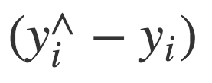
Linear Regression
Error in Prediction
4
3
1
y₁
House Value (In $)
5
y₁^
2
House Area (In Sq ft)

Slide 41
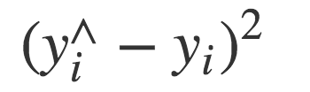
Linear Regression
Squared Error
4
3
1
y₁
House Value (In $)
5
y₁^
2
House Area (In Sq ft)

Slide 42
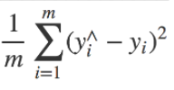
Linear Regression
Mean Square Error
4
3
1
y₁
House Value (In $)
5
y₁^
2
House Area (In Sq ft)

Slide 43
Linear Regression
How Do We Train the Model?
While training the model
We have to find the value of θ (Feature value weights)
That minimizes the MSE - Mean Squared Error

Slide 44
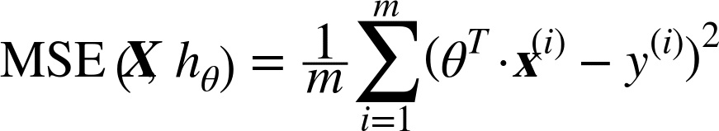
Linear Regression
Mean Square Error - MSE
The MSE of a Linear Regression hypothesis h_{θ} on a training set X is calculated using below equation

Slide 45
Linear Regression
Mean Square Error - MSE
Where
x^{(i)} is a vector of all the feature values (excluding the label) of the i^{th} instance in the dataset
y^{(i)} is its label (the desired output value for that instance)

Slide 46
Linear Regression
Mean Square Error - MSE
For example, if the first district in the dataset is located at
longitude –118.29°
latitude 33.91° and
It has 1,416 inhabitants with a
Median income of $38,372, and
Median house value is $156,400, then

Slide 47
Linear Regression
Key Thought
While training models we just have to find θ(model parameters or feature weights) which minimizes the RMSE

Slide 48
Linear Regression
Minimise MSE
Let’s understand how the training of linear regression model done internally
There are two approaches to train the linear regression model
The normal “closed-form” equation
Gradient Descent (GD) - Iterative optimization approach

Slide 49
Linear Regression
The Normal Equation

Slide 50
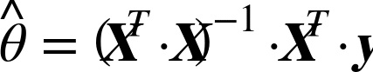
The Normal Equation
It is a mathematical equation that gives the result directly
Hence it is a closed-form solution
Value of θ that minimizes the cost function
y is the vector of target values containing y⁽¹⁾ to y^{(m)}
More on wikipedia

Slide 51
The Normal Equation
X is training dataset
Notes:
https://en.wikipedia.org/wiki/Linear_least_squares_(mathematics)

Slide 52
The Normal Equation
Let’s test the equation

Slide 53
The Normal Equation
First, generate some linear looking data
>>> import numpy as np
# Uniformly distributed array with dimension (100, 1)
>>> X = 2 * np.random.rand(100, 1)
# Normally distributed array with noise
>>> y = 4 + 3 * X + np.random.randn(100, 1)
θ₀
θ₁
Gaussian Noise

Slide 54
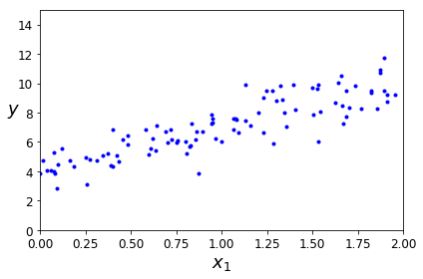
The Normal Equation
Let plot the chart to see if X and y have linear relation
>>> plt.plot(X, y, "b.")
>>> plt.xlabel("$x_1$", fontsize=18)
>>> plt.ylabel("$y$", rotation=0, fontsize=18)
>>> plt.axis([0, 2, 0, 15])
>>> plt.show()
Output

Slide 55
The Normal Equation
Let plot the chart to see if X and y have linear relation
>>> plt.plot(X, y, "b.")
>>> plt.xlabel("$x_1$", fontsize=18)
>>> plt.ylabel("$y$", rotation=0, fontsize=18)
>>> plt.axis([0, 2, 0, 15])
>>> plt.show()
Output
X and y have linear relation

Slide 56
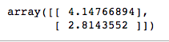
The Normal Equation
Let’s compute theta hat using the Normal Equation
# Add Bias term x0 = 1
>>> X_b = np.c_[np.ones((100, 1)), X]
# Apply the normal equation
>>> theta_best = np.linalg.inv(X_b.T.dot(X_b)).dot(X_b.T).dot(y)

Slide 57
The Normal Equation
Weights in Original Equation
Learned Weights from Normal Equation
y = 4 + 3 * X + np.random.randn(100, 1)
Original
θ₀ = 4
θ₁ = 3
From Normal Equation
θ₀ = 4.14
θ₁ = 2.81

Slide 58
The Normal Equation
Weights in Original Equation
Learned Weights from Normal Equation
y = 4 + 3 * X + np.random.randn(100, 1)
Original
θ₀ = 4
θ₁ = 3
From Normal Equation
θ₀ = 4.14
θ₁ = 2.81
Not bad!
Learned weights are approximately same as original weights

Slide 59
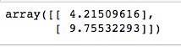
The Normal Equation
Let’s make predictions using theta_best
>>> X_new = np.array([[0], [2]])
# add x0 = 1 to each instance
>>> X_new_b = np.c_[np.ones((2, 1)), X_new]
>>> y_predict = X_new_b.dot(theta_best)
Output-

Slide 60
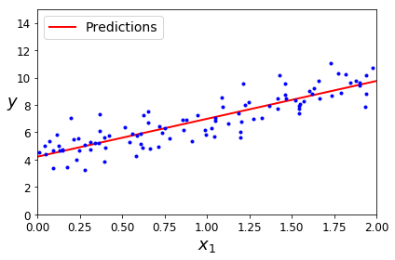
The Normal Equation
Let’s plot the models predictions
>>> plt.plot(X_new, y_predict, "r-", linewidth=2, label="Predictions")
>>> plt.plot(X, y, "b.")
>>> plt.xlabel("$x_1$", fontsize=18)
>>> plt.ylabel("$y$", rotation=0, fontsize=18)
>>> plt.legend(loc="upper left", fontsize=14)
>>> plt.axis([0, 2, 0, 15])
>>> plt.show()
Output-

Slide 61
The Normal Equation
We can also use Scikit-Learn for the previous steps
>>> from sklearn.linear_model import LinearRegression
>>> lin_reg = LinearRegression()
>>> lin_reg.fit(X, y)
>>> lin_reg.intercept_, lin_reg.coef_
Output-

Slide 62
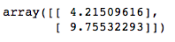
The Normal Equation
>>> lin_reg.predict(X_new)
Output-

Slide 63
The Normal Equation
Computational Complexity - For Features
The Normal Equation
Computes the inverse of X^{T} · X
Which is an n * n matrix (where n is the number of features)
Depending on the implementation
The computational complexity of inverting such a matrix is
Typically about O(n^{2.4}) to O(n³) depending on the implementation

Slide 64
The Normal Equation
Computational Complexity - For Features
If we double the number of features
Then the computation time gets increased by
2^{2.4} to 2³ = (~= 5.3 to 8) times
That is why the Normal Equation gets very slow
When the number of features grows large

Slide 65
The Normal Equation
Computational Complexity - For Training Set
The normal equation is
Linear with regards to the number of instances in the training set
So it handles large training sets efficiently
Provided they can fit in memory

Slide 66
The Normal Equation
Computational Complexity
Let’s explore different ways to train a Linear Regression model which are
Better suited for cases where there are a large number of features
Or too many training instances to fit in memory

Slide 67
Linear Regression
Gradient Descent

Slide 68

Gradient Descent
Question - If you are lost in the mountains in a dense fog and you can only feel the slope of the ground below your feet. Which strategy will you take to reach to the bottom of the valley quickly?
Your Current position
Bottom of the valley

Slide 69
Gradient Descent
Answer
Take a step
If the step is downhill, keep walking on the same direction
Else reverse the direction
Repeat the steps until you reach to the bottom
Your Current position
Bottom of the valley

Slide 70
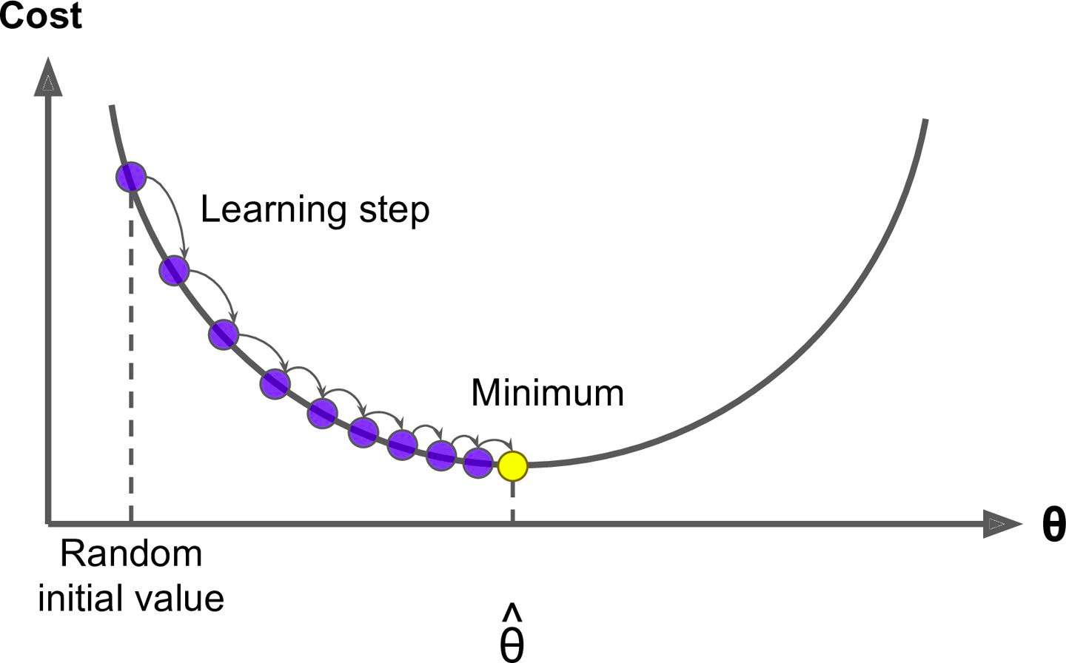
Gradient Descent

Slide 71
Gradient Descent
Gradient Descent
Measures the local gradient of the cost function
With regards to the parameter vector θ and
It goes in the direction of descending gradient
Until the gradient becomes zero

Slide 72
Gradient Descent
Random Initialization
We start by filling θ with random values - Random initialization
Improve it gradually, taking one baby step at a time
Each step attempts to decrease the cost function - MSE
Until the algorithm converges to a minimum

Slide 73
Gradient Descent
Learning Rate
In Gradient Descent
The size of the steps - also called as learning rate plays an important role

Slide 74
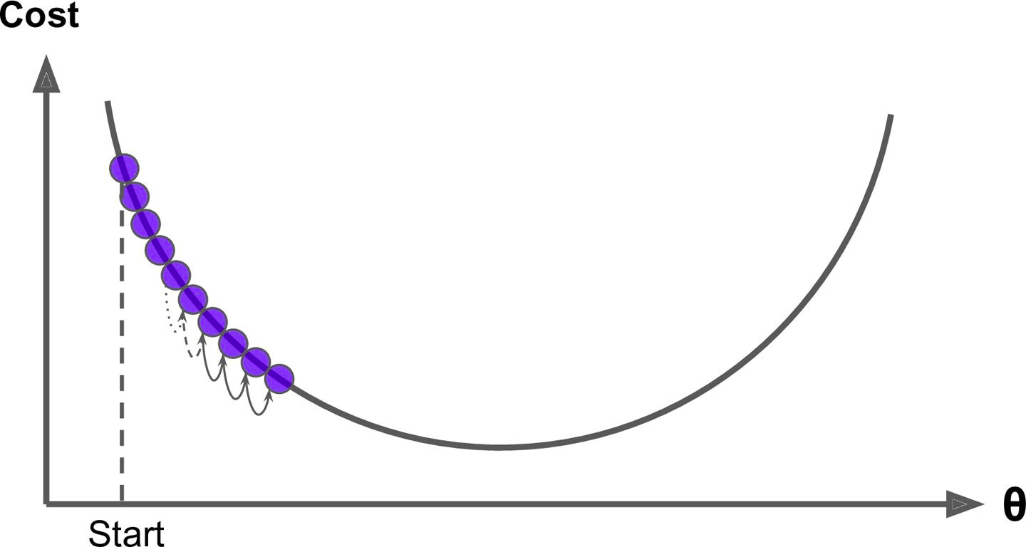
Gradient Descent
Learning Rate
If the learning rate is too small
Then the algorithm will have to go through many iterations to converge
Which will take a long time to converge

Slide 75
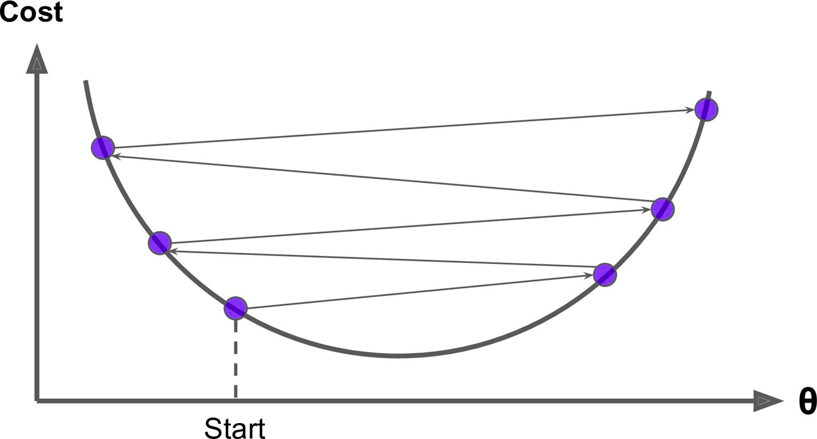
Gradient Descent
Learning Rate
If the learning rate is too high
We might jump across the valley
and end up on the other side, possibly even higher up than you were before

Slide 76
Gradient Descent
Learning Rate
If the learning rate is too high
This might make the algorithm diverge with
Larger and larger values, failing to find a good solution

Slide 77
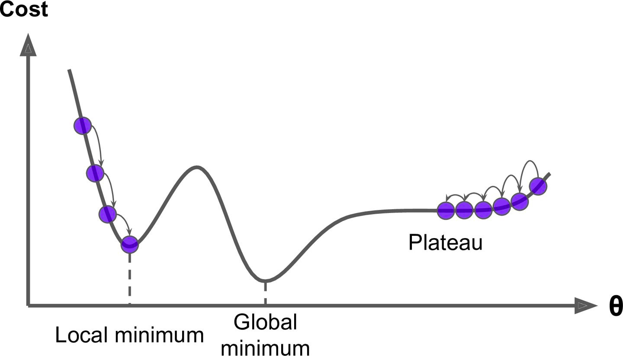
Gradient Descent
Global and Local Minimum
Not all cost functions are regular bowls
There may be holes, ridges, plateaus, and all sorts of irregular terrains, making convergence to the minimum very difficult

Slide 78
Gradient Descent
Global and Local Minimum
If we start from left then Gradient Descent
Converges to a local minimum
Which is not as good as the global minimum

Slide 79
Gradient Descent
Global and Local Minimum
If we start from right then Gradient Descent
Will take a very long time to cross the plateau and
If we stop too early then
We will never reach the global minimum

Slide 80
Gradient Descent
Global and Local Minimum
MSE cost function is a convex function
If we pick any two points on the curve
The line segment joining them never crosses the curve
No local minima, just one global minimum
Convex Function

Slide 81
Gradient Descent
Feature Scaling
When using Gradient Descent, we should ensure that
All features have a similar scale
Using Scikit-Learn’s StandardScaler class
Else it will take much longer to converge

Slide 82
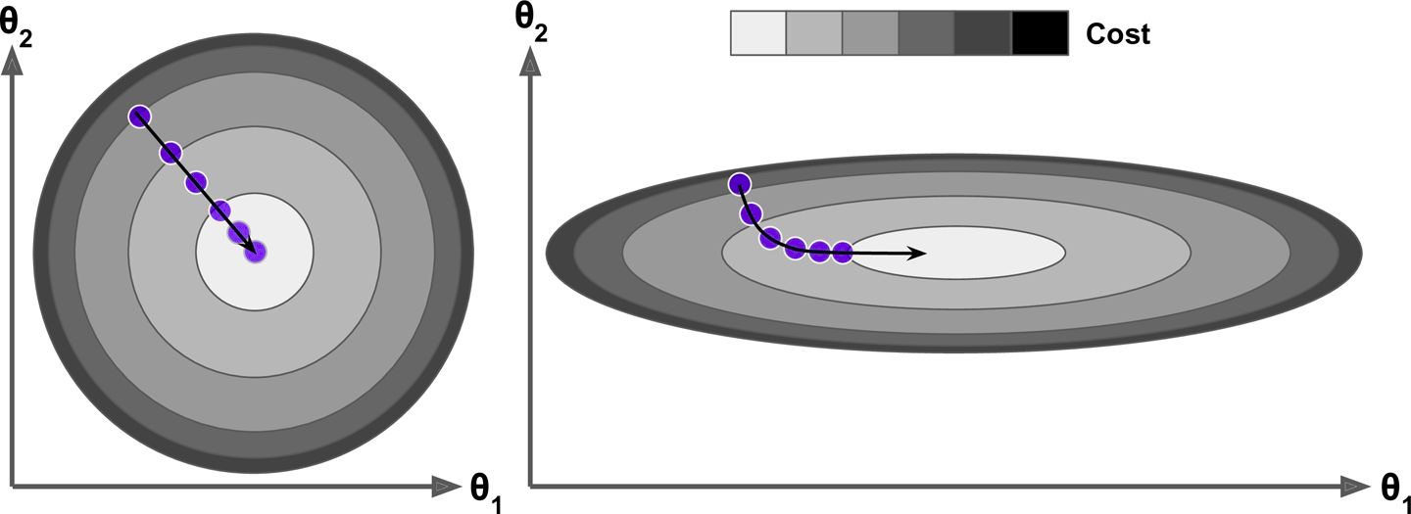
Gradient Descent
Feature Scaling - Same Scales
See the below diagram where feature 1 and 2 have same scales
Gradient Descent algorithm goes straight toward the minimum
Thereby reaching it quickly
Same Scale

Slide 83
Gradient Descent
Feature Scaling - Different Scales / Not scaled
See the below diagram where feature 1 and 2 have different scales
Different Scale

Slide 84
Gradient Descent
Feature Scaling - Different Scales
Gradient Descent algorithm goes almost orthogonal to
The direction of the global minimum and
It ends with a long march down an almost flat valley
It will eventually reach the minimum, but it will take a long time
Different Scale

Slide 85
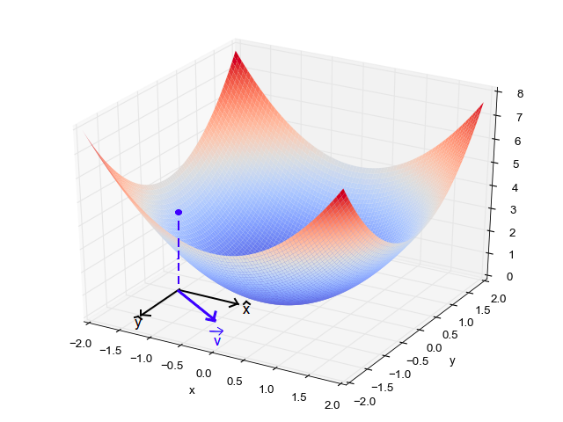
Gradient Descent
Features and Cost Function
Cost
Feature 2
Feature 1

Slide 86
Gradient Descent
Again remember that training a model means
Searching for a best possible model’s parameters
Like θ₀, θ₁ and others
That minimizes the cost function like MSE
Algorithm will have to search in more dimensions if
Model has more features
And search becomes complex

Slide 87
Gradient Descent
Let’s implement Gradient descent now using some known algorithms such as
Batch Gradient Descent
Stochastic Gradient Descent
Mini-batch Gradient Descent

Slide 88
Gradient Descent
Batch Gradient Descent

Slide 89
Batch Gradient Descent
Partial Derivative
To implement Gradient Descent
First initialize model parameters(θ₁, θ₂ …..) - Random Initialization
For each of the weights, we change one weight and keeping others fixed and calculate the change in cost
This is called a Partial Derivative

Slide 90
Batch Gradient Descent
Partial Derivative
It is like asking
What is the slope of the mountain under my feet if I face east?
And then asking the same question facing north
And so on for all other dimensions

Slide 91
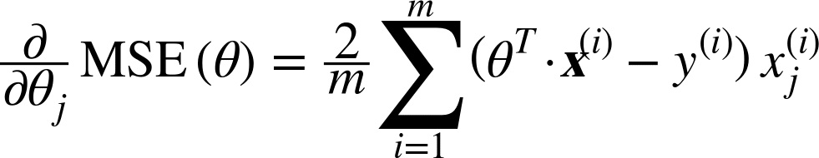
Batch Gradient Descent
Partial Derivative of Cost Function
In general, we compute the gradient of the cost function
With regards to each model parameter θj (Theta j)
Below is the equation for finding partial derivative of the cost function with respect to parameter θj (Theta j)

Slide 92
Batch Gradient Descent
Partial Derivative of Cost Function
In this equation
We calculate partial derivative wrt each parameter θj (Theta j) individually
Instead we can compute them all in one go

Slide 93
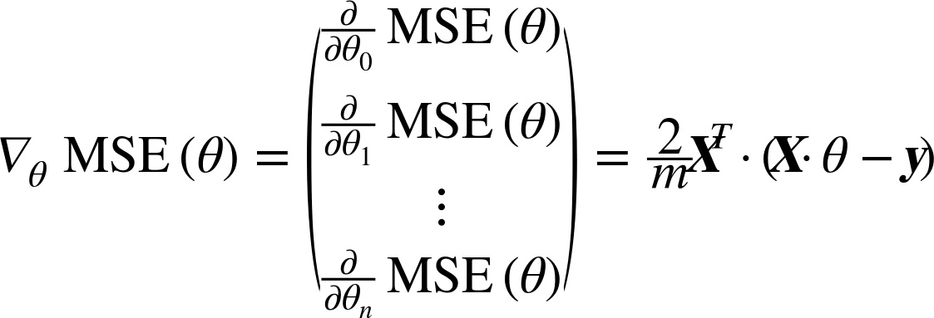
Batch Gradient Descent
Gradient Vector of the Cost Function
The gradient vector ∇_{θ}MSE(θ)
Contains all the partial derivatives of the cost function
(one for each model parameter)

Slide 94
Batch Gradient Descent
Gradient Vector of the Cost Function
This formula involves calculations over the full training set X at every step
This is why the name Batch Gradient Descent

Slide 95
Batch Gradient Descent
Gradient Vector of the Cost Function
Since Batch Gradient Descent uses entire training data at every step
It is terribly slow on large training sets
But Gradient Descent scales well with the number of features
It is faster to train Linear Regression model when there are thousand of features
Using Gradient Descent than using the Normal Equation

Slide 96
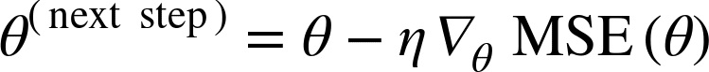
Batch Gradient Descent
Gradient Descent Step
Once we have the gradient vector, which points uphill,
Just go in the opposite direction to go downhill
We can calculate the size of the downhill step using below equation
Learning Rate

Slide 97
Batch Gradient Descent
Quick Implementation of the Algorithm
>>> eta = 0.1
>>> n_iterations = 1000
>>> m = 100
>>> theta = np.random.randn(2,1)
>>> for iteration in range(n_iterations):
gradients = 2/m * X_b.T.dot(X_b.dot(theta) - y)
theta = theta - eta * gradients

Slide 98
Batch Gradient Descent
Quick Implementation of the Algorithm
>>> eta = 0.1
>>> n_iterations = 1000
>>> m = 100
>>> theta = np.random.randn(2,1)
>>> for iteration in range(n_iterations):
gradients = 2/m * X_b.T.dot(X_b.dot(theta) - y)
theta = theta - eta * gradients
Let’s understand the program

Slide 99
Batch Gradient Descent
Quick Implementation of the Algorithm
>>> eta = 0.1 # Learning Rate
>>> n_iterations = 1000
>>> m = 100
>>> theta = np.random.randn(2,1)
>>> for iteration in range(n_iterations):
gradients = 2/m * X_b.T.dot(X_b.dot(theta) - y)
theta = theta - eta * gradients

Slide 100
Batch Gradient Descent
Quick Implementation of the Algorithm
>>> eta = 0.1
>>> n_iterations = 1000 # Number of iterations after which algorithm stops
>>> m = 100
>>> theta = np.random.randn(2,1)
>>> for iteration in range(n_iterations):
gradients = 2/m * X_b.T.dot(X_b.dot(theta) - y)
theta = theta - eta * gradients

Slide 101
Batch Gradient Descent
Quick Implementation of the Algorithm
>>> eta = 0.1
>>> n_iterations = 1000
>>> m = 100 # Number of elements in training dataset
>>> theta = np.random.randn(2,1)
>>> for iteration in range(n_iterations):
gradients = 2/m * X_b.T.dot(X_b.dot(theta) - y)
theta = theta - eta * gradients

Slide 102
Batch Gradient Descent
Quick Implementation of the Algorithm
>>> eta = 0.1
>>> n_iterations = 1000
>>> m = 100
>>> theta = np.random.randn(2,1) # Random initialization of model parameters
>>> for iteration in range(n_iterations):
gradients = 2/m * X_b.T.dot(X_b.dot(theta) - y)
theta = theta - eta * gradients

Slide 103
Batch Gradient Descent
Quick Implementation of the Algorithm
>>> eta = 0.1
>>> n_iterations = 1000
>>> m = 100
>>> theta = np.random.randn(2,1)
>>> for iteration in range(n_iterations):
gradients = 2/m *X_b.T.dot(X_b.dot(theta) - y) # Gradient vector of the cost function
theta = theta - eta * gradients

Slide 104
Batch Gradient Descent
Quick Implementation of the Algorithm
>>> eta = 0.1
>>> n_iterations = 1000
>>> m = 100
>>> theta = np.random.randn(2,1)
>>> for iteration in range(n_iterations):
gradients = 2/m * X_b.T.dot(X_b.dot(theta) - y)
theta = theta - eta * gradients # Determine the size of the downhill step

Slide 105
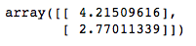
Batch Gradient Descent
Quick Implementation of the Algorithm
>>> eta = 0.1
>>> n_iterations = 1000
>>> m = 100
>>> theta = np.random.randn(2,1)
>>> for iteration in range(n_iterations):
gradients = 2/m * X_b.T.dot(X_b.dot(theta) - y)
theta = theta - eta * gradients

Slide 106
Batch Gradient Descent
Quick Implementation of the Algorithm
>>> eta = 0.1
>>> n_iterations = 1000
>>> m = 100
>>> theta = np.random.randn(2,1)
>>> for iteration in range(n_iterations):
gradients = 2/m * X_b.T.dot(X_b.dot(theta) - y)
theta = theta - eta * gradients
Output
Theta is same like Normal Equation

Slide 107
Batch Gradient Descent
How the learning rate affects Gradient Descent?

Slide 108
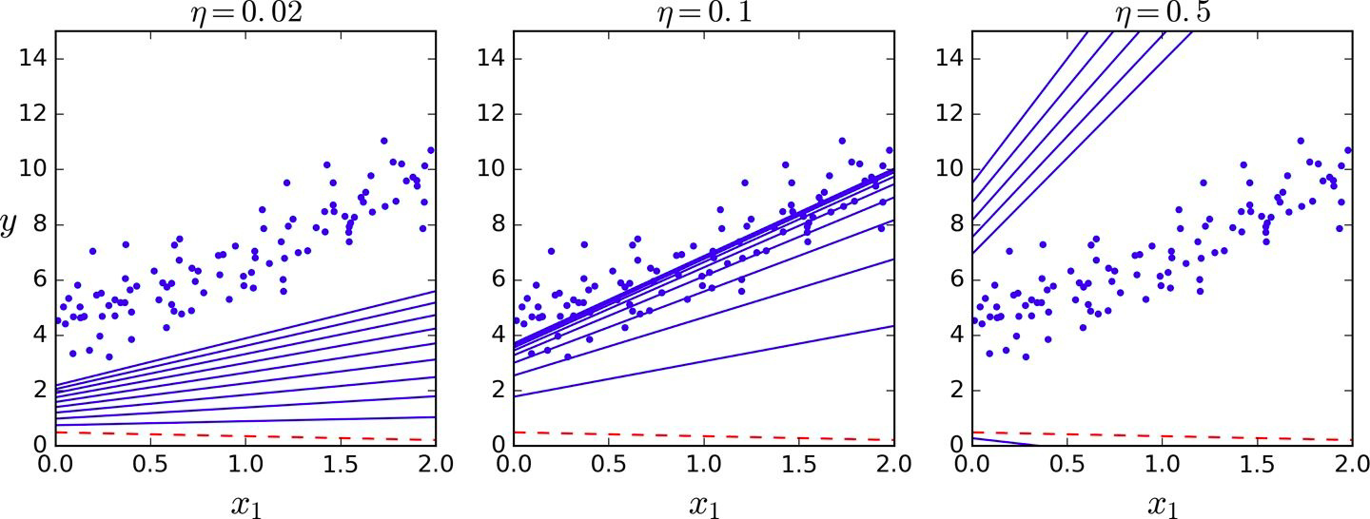
Batch Gradient Descent
First 10 steps of Gradient Descent using three different learning rates
The dashed line - - - - represents the starting point
Gradient Descent with Various Learning Rates (See the code in notebook)

Slide 109
Batch Gradient Descent
Different Learning Rates
Learning rate is too low (0.02)
Algorithm will take a lot of time to reach the solution

Slide 110
Batch Gradient Descent
Different Learning Rates
Learning rate is good (0.1)
In few iterations only, it converged to good solution

Slide 111
Batch Gradient Descent
Different Learning Rates
Learning rate is too high (0.5)
The algorithm diverges
Jumping all over the place and
Getting further and further away from the solution at every step

Slide 112
Batch Gradient Descent
Then how to find good learning rate?

Slide 113
Batch Gradient Descent
Find Good Learning Rate
Remember grid search from end-to-end project?
Use grid search to find good learning rate
But limit the number of iterations
So that grid search can eliminate models that take too long to converge

Slide 114
Batch Gradient Descent
Then how to set number of iterations?

Slide 115
Batch Gradient Descent
Find Number of Iterations
If number of iterations are too low
Then we may not get optimal solution when the algorithm stops
If number of iterations are too high
Then our time may be wasted and
Algorithm may never converge

Slide 116
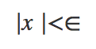
Batch Gradient Descent
Find Good Learning Rate - Solution
Set a very large number of iterations and
Interrupt the algorithm when the gradient vector becomes tiny
When norm of a gradient vector becomes smaller than ϵ - tolerance
Norm of vector (x1, x2 --- xn)
Stop when

Slide 117
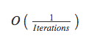
Batch Gradient Descent
Convergence Rate
For MSE
Batch Gradient Descent with a fixed learning rate has a convergence rate of
If we divide the tolerance ε by 10 to have a more precise solution
Then the algorithm will have to run about 10 times more iterations

Slide 118
Stochastic Gradient Descent (SGD)

Slide 119
Stochastic Gradient Descent - SGD
Problem with Batch Gradient Descent
Batch Gradient Descent
Slow when the training set is large
As it uses the whole training set to compute the gradient at every step
Stochastic Gradient Descent
Just picks a random instance in the training set at every step and
Computes the gradients based only on that single instance

Slide 120
Stochastic Gradient Descent - SGD
This makes the algorithm much faster
As very little data gets manipulated at every iteration
Also huge training sets can be trained
As only one instance needs to be in memory at each iteration

Slide 121
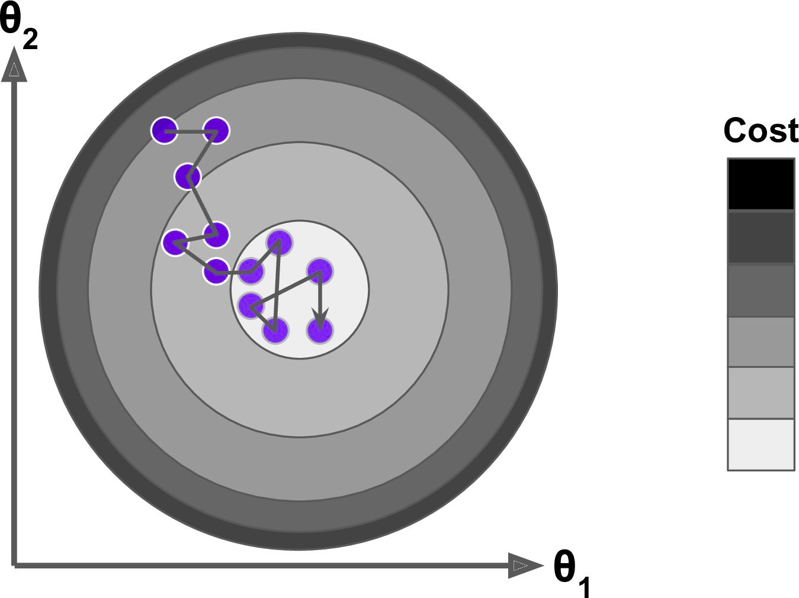
Stochastic Gradient Descent - SGD

Slide 122
Stochastic Gradient Descent - SGD
Instead of gently decreasing until it reaches the minimum
The cost function bounces up and down, decreasing only on average
Over time it ends up very close to the minimum
But once it gets there it continues to bounce around, never settling down

Slide 123
Stochastic Gradient Descent - SGD
Once the algorithm stops
The final parameter values are good, but not optimal
As algorithm never settles down

Slide 124
Stochastic Gradient Descent - SGD
When the cost function is very irregular then
SGD has a better chance of finding the global minimum than Batch Gradient Descent
As randomness may help algorithm to jump out of local minima

Slide 125
Stochastic Gradient Descent - SGD
As seen earlier that randomness in SGD
Is good to escape from local minimum
But bad as algorithm can never settle at minimum

Slide 126
Stochastic Gradient Descent - SGD
As seen earlier that randomness in SGD
Is good to escape from local minimum
But bad as algorithm can never settle at minimum
What is the solution?

Slide 127
Stochastic Gradient Descent - SGD
Simulated Annealing
One solution is to gradually reduce the learning rate
The steps start out large
This helps make quick progress and escape local minima
Then steps get smaller and smaller
This helps the algorithm to settle at the global minimum
This process is called Simulated Annealing
Because it resembles the process of annealing in metallurgy where molten metal is slowly cooled down

Slide 128
Stochastic Gradient Descent - SGD
Learning Schedule
The function that determines the learning rate
At each iteration is called the learning schedule
If the learning rate is reduced too quickly
We may get stuck in a local minimum Or
Even end up frozen halfway to the minimum
If the learning rate is reduced too slowly
We may jump around the minimum for a long time and
End up with a suboptimal solution if we halt training too early

Slide 129
Stochastic Gradient Descent - SGD
Implement SGD
Let’s implement SGD
By convention we iterate by rounds of m iterations
Each round is called an epoch
m -> number of instances in the training set

Slide 130
Stochastic Gradient Descent - SGD
Implement SGD
Let’s implement SGD
By convention we iterate by rounds of m iterations
Each round is called an epoch
m -> number of instances in the training set
See Stochastic Gradient Descent section in notebook for the implementation

Slide 131
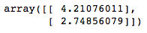
Stochastic Gradient Descent - SGD
Implement SGD
Output

Slide 132
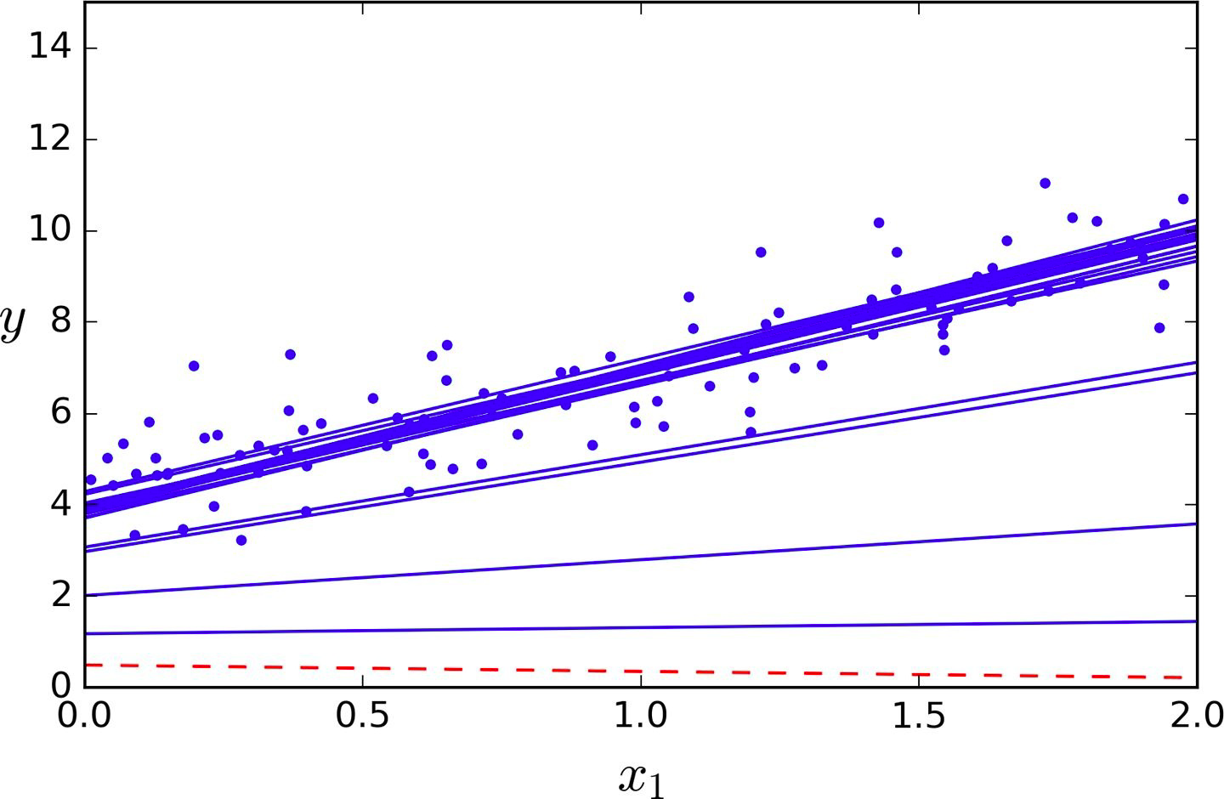
Stochastic Gradient Descent - SGD
Implement SGD
SGD first 10 steps. Notice how irregular the steps are

Slide 133
Stochastic Gradient Descent - SGD
Scikit-Learn SGDRegressor Class
To perform linear regression using Scikit-Learn
Use SGDRegressor class
SGDRegressor class by default optimizes the squared error cost function

Slide 134
Stochastic Gradient Descent - SGD
Scikit-Learn SGDRegressor Class
>>> from sklearn.linear_model import SGDRegressor
>>> sgd_reg = SGDRegressor(n_iter=50, penalty=None, eta0=0.1)
>>> sgd_reg.fit(X, y.ravel())
>>> sgd_reg.intercept_, sgd_reg.coef_
n_iter ---> Number of epochs
eta ---> Learning rate
penalty ---> None means do not use any regularization

Slide 135
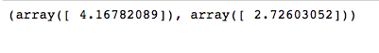
Stochastic Gradient Descent - SGD
Scikit-Learn SGDRegressor Class
>>> from sklearn.linear_model import SGDRegressor
>>> sgd_reg = SGDRegressor(n_iter=50, penalty=None, eta0=0.1)
>>> sgd_reg.fit(X, y.ravel())
>>> sgd_reg.intercept_, sgd_reg.coef_
Output
Solution is very close to the Normal Equation

Slide 136
Mini-batch Gradient Descent

Slide 137
Mini-batch Gradient Descent
The last Gradient Descent algorithm we will look into
Quite easy to understand if we know both
Batch and
Stochastic Gradient Descent

Slide 138
Mini-batch Gradient Descent
At each step
Instead of computing the gradients based on the full training set (as in Batch GD) or
Based on just one instance (as in Stochastic GD)
Mini-batch GD computes the gradients on small random sets of instances called mini-batches

Slide 139
Mini-batch Gradient Descent
Advantages
The main advantage of Mini-batch GD over Stochastic GD is that
We can get a performance boost
From hardware optimization of matrix operations
Especially when using GPUs

Slide 140
Mini-batch Gradient Descent
Advantages
Mini-batch GD algorithm’s progress is
Less erratic than SGD
Especially with fairly large mini-batches
As a result it goes more closer to minimum than SGD

Slide 141
Mini-batch Gradient Descent
Disadvantages
It is harder for Mini-batch GD to escape from local minima

Slide 142
Mini-batch Gradient Descent
Implement Mini-batch GD
See Mini-batch gradient descent section in notebook for the implementation

Slide 143
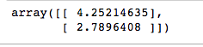
Mini-batch Gradient Descent
Implement Mini-batch GD
As we can see
For each epoch (as in SGD)
We are creating mini-batches from the training dataset (as in Batch GD)
Output

Slide 144
Mini-batch Gradient Descent
Let’s see the path taken by below algorithms during training
Batch GD
Stochastic GD
Mini-batch GD
For code please see the notebook

Slide 145
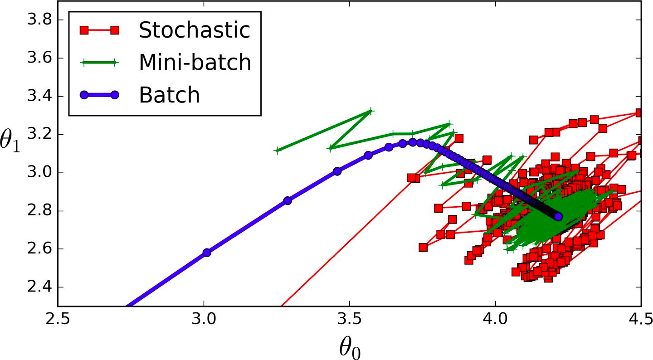
Mini-batch Gradient Descent
Gradient Descent paths in parameter space during training

Slide 146
Mini-batch Gradient Descent
Observations??

Slide 147
Mini-batch Gradient Descent
Observation - 1
All the three algorithms end up near the minimum

Slide 148
Mini-batch Gradient Descent
Observation - 2
Batch GD’s path actually stops at the minimum

Slide 149
Mini-batch Gradient Descent
Observation - 3
Both Stochastic GD and Mini- batch GD continue to walk around

Slide 150
Mini-batch Gradient Descent
Observation - 4
Batch GD takes a lot of time to take each step

Slide 151
Mini-batch Gradient Descent
Note - 1
While Batch GD takes a lot of time
Both Stochastic GD and Mini-batch GD can reach the minimum provided good learning schedule

Slide 152
Mini-batch Gradient Descent
Note - 2
There is almost no difference after training
All these three algorithms end up with very similar models and
Make predictions in exactly the same way

Slide 153
Comparison
Let’s compare all the three algorithms for Linear Regression

Slide 154
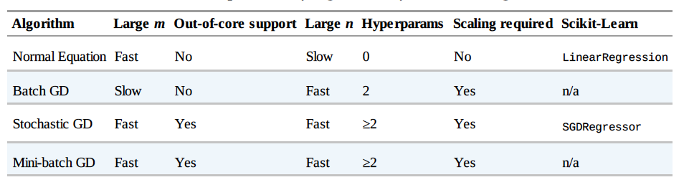
Comparison
m is the number of training instances
n is the number of features

Slide 155
Faster Optimizers
See: D4. Training Deep Neural Nets (Slide 171 onwards)

Slide 156
Linear Regression
Polynomial Regression

Slide 157
Polynomial Regression
So far we have just looked at the data having
A linear relationship or
Straight line

Slide 158
Polynomial Regression
So far we have just looked the data having
A linear relationship or
Straight line
What if we have to fit nonlinear data like quadratic equation?

Slide 159
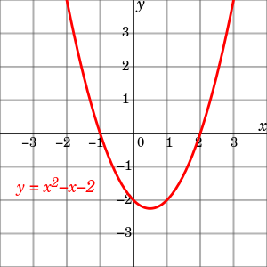
Polynomial Regression
Quadratic Equation
Graph of the quadratic equation y = x^2 - x - 2

Slide 160
Polynomial Regression
Quadratic Equation
Clearly a straight line will never fit this data properly

Slide 161
Polynomial Regression
Quadratic Equation
Then how do we fit this kind of nonlinear data?

Slide 162
Polynomial Regression
We can use
A linear model to fit nonlinear data
Add powers of each feature as new features
And train a linear model on extended set of features
This is called polynomial regression

Slide 163
Polynomial Regression
Let’s test it
First generate some nonlinear data
Based on a quadratic equation
Plus some noise

Slide 164
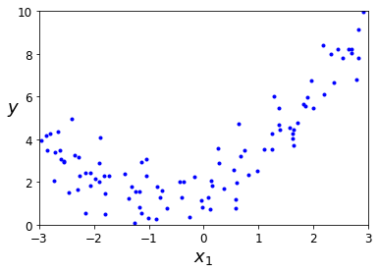
Polynomial Regression
Generate Nonlinear Data with Noise
>>> m = 100
>>> X = 6 * np.random.rand(m, 1) - 3
>>> y = 0.5 * X**2 + X + 2 + np.random.randn(m, 1)
Generated nonlinear and noisy dataset

Slide 165
Polynomial Regression
Scikit-Learn’s PolynomialFeatures Class
Use PolynomialFeatures class to transform the training data
Add square of each feature in the training set as new features
new features = existing features in training set + square of each feature in training set

Slide 166
Polynomial Regression
Scikit-Learn’s PolynomialFeatures Class
>>> from sklearn.preprocessing import PolynomialFeatures
>>> poly_features = PolynomialFeatures(degree=2, include_bias=False)
>>> X_poly = poly_features.fit_transform(X)
>>> X[0]

Slide 167
Polynomial Regression
Scikit-Learn’s PolynomialFeatures Class
>>> X[0]
array([-0.75275929])
Original features
>>> X_poly[0]
array([-0.75275929, 0.56664654])
X_poly now contains the original feature of X plus the square of this feature

Slide 168
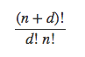
Polynomial Regression
Scikit-Learn’s PolynomialFeatures Class
PolynomialFeatures with degree=d
Transforms an array containing n features into an array containing
features

Slide 169
Polynomial Regression
Scikit-Learn’s PolynomialFeatures Class
Polynomial Regression is capable of finding relationships between features
Which plain Linear Regression model can not do
This is because PolynomialFeatures adds all combinations of features
Up to the given degree

Slide 170
Polynomial Regression
Scikit-Learn’s PolynomialFeatures Class
For example
If there are two features a and b
PolynomialFeatures with degree=3 will add these features alse
a², a³, b², and b³
Also ab, a²b, and ab²

Slide 171
Polynomial Regression
Fit a LinearRegression model
Now fit a LinearRegression model to this extended training data
>>> lin_reg = LinearRegression()
>>> lin_reg.fit(X_poly, y)
>>> lin_reg.intercept_, lin_reg.coef_

Slide 172
Polynomial Regression
Fit a LinearRegression model
Output -
(array([ 1.78134581]), array([[ 0.93366893, 0.56456263]]))
Model Estimation -

Slide 173
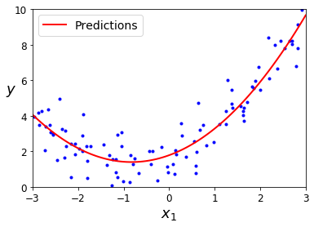
Polynomial Regression
Polynomial Regression model predictions

Slide 174
Linear Regression
Learning Curves

Slide 175
Learning Curves
As we have seen earlier
High-degree polynomial regression fits the training data
Much better than plain linear regression
Let’s look at the fit of
Plain Linear Regression
2nd-degree Polynomial Regression and
300-degree Polynomial Regression
See the code in Learning curves section in notebook

Slide 176
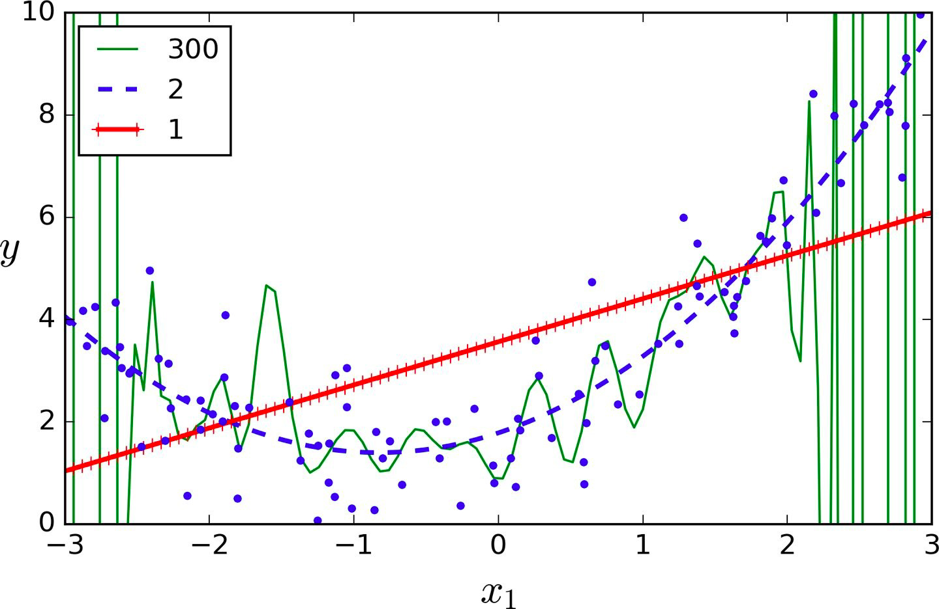
Learning Curves
High-degree Polynomial Regression

Slide 177
Learning Curves
-- Plain Linear
Regression
-- 2nd-degree Polynomial
Regression
-- 300-degree Polynomial
Regression

Slide 178
Learning Curves
As we can see in the previous diagram
300-degree polynomial model
Wiggles around to get as close as possible
To the training instances
It is clear that
The high-degree Polynomial Regression model is severely overfitting the training data and
The linear model is underfitting the training data

Slide 179
Learning Curves
How do we find if model is overfitting or underfitting the training data?

Slide 180
Learning Curves
One approach is to use cross-validation

Slide 181
Learning Curves
If a model
Performs well on the training data
But generalizes poorly according to the cross-validation
Then model is overfitting
In this case model is too complex
If a model
Performs poorly on both
Training data and cross-validation
Then model is underfitting
In this case model is too simple

Slide 182
Learning Curves
Another approach is to look at learning curves

Slide 183
Learning Curves
Learning curves are
Plots of the model’s performance on
The training set and the validation set
As a function of the training set size
To generate the plots
Simply train the model
Several times on different sized subsets of the training set

Slide 184
Learning Curves
Learning curves of the plain Linear Regression model
Let’s plot the learning curves
We’ll train the model on different subsets of training set
And plot the RMSE and Training set size
Switch to the notebook for the code

Slide 185
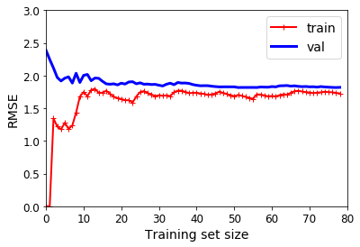
Learning Curves
Learning curves of the plain Linear Regression model

Slide 186
Learning Curves
Let’s look at performance of the model on the training set
When there are just one or two instances in the training set
The model can fit them perfectly
Which is why the curve starts at zero

Slide 187
Learning Curves
Let’s look at performance of the model on the training set
But as new instances are added to the training set
It becomes impossible for the model to fit the training data perfectly
Both because the data is noisy and
Because it is not linear at all

Slide 188
Learning Curves
Let’s look at performance of the model on the training set
The error on the training data goes up until it reaches a plateau
At that point adding new instances to the training set
Doesn’t make the error much better or worse

Slide 189
Learning Curves
Let’s look at performance of the model on the validation set
When the model is trained on very few training instances
It is incapable of generalizing properly
Which is why the validation error is initially quite big

Slide 190
Learning Curves
Let’s look at performance of the model on the validation set
As the model is shown more training examples
It learns and thus the validation error slowly goes down

Slide 191
Learning Curves
Let’s look at performance of the model on the validation set
Since straight line can not do a good job modeling the data
So the error ends up at a plateau
Very close to the other curve

Slide 192
Learning Curves
Tip
These learning curves are examples of an underfitting model
Both curves have reached a plateau
They are close and RMSE is fairly high

Slide 193
Learning Curves
Tip
If model is underfitting the training data
Then adding more training data will not help
We need to use a more complex model or
Come up with better features

Slide 194
Learning Curves
Let’s plot the learning curves of a 10th-degree polynomial model on the same data
Switch to the notebook for the code

Slide 195
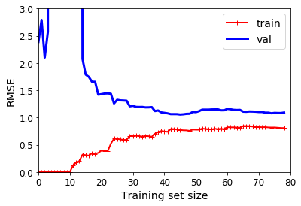
Learning Curves
Learning curves of a 10th-degree polynomial model

Slide 196
Learning Curves
Observations
The error on the training data (~0.5 RMSE) is much lower than with the Linear Regression model (~1.5 - 2 RMSE)

Slide 197
Learning Curves
Observations
There is a gap between the curves
This means that the model performs significantly better on the
Training data than on the validation data
Which shows model is overfitting the training set

Slide 198
Learning Curves
Observations
On a larger training set
The two curves continue to get closer

Slide 199
Learning Curves
Tip
One way to improve an overfitting model is to
Feed it more training data
Until the validation error reaches the training error

Slide 200
Learning Curves
The Bias / Variance Tradeoff
A model’s generalization error can be expressed as the sum of three very different errors
Bias
Variance and
Irreducible error

Slide 201
Learning Curves
The Bias / Variance Tradeoff - Bias error
This error is due to wrong assumptions such as
Assuming that the data is linear
When it is actually quadratic
A high-bias model is most likely to underfit the training data

Slide 202
Learning Curves
The Bias / Variance Tradeoff - Variance
A model with many degrees of freedom
Such as a high-degree polynomial model is likely to have
High variance and thus overfits the training data

Slide 203
Learning Curves
The Bias / Variance Tradeoff - Irreducible error
This error is due to the noisiness of the data itself
The only way to reduce this part of the error is to
Clean up the data
Such as fix
The data sources
Broken sensors or
Detect and remove outliers

Slide 204
Learning Curves
The Bias / Variance Tradeoff
Increasing a model’s complexity
Increases its variance and
Reduce its bias
Conversely, reducing a model’s complexity
Increases its bias and
Reduces its variance
This is why it is called a tradeoff

Slide 205
Regularized Linear Models

Slide 206
Regularized Linear Models
As we saw earlier, a good way to reduce overfitting is to
Regularize the model - Constraint it
It is hard for a model to overfit data if it has less degree of freedom
Example
To regularize a polynomial model, reduce the number of polynomial degrees

Slide 207
Regularized Linear Models
For a linear model
Regularization is achieved by
Constraining the weights of the model
There are different ways to constrain the weights like
Ridge Regression
Lasso Regression and
Elastic Net

Slide 208
Regularized Linear Models
Let’s understand L1 and L2 norms first

Slide 209
Regularized Linear Models
Different Performance Measures
We’ve already looked into RMSE (Root Mean Square Error) as a performance measure
RMSE is generally the preferred performance measure for regression tasks
But in some cases we may want to use another performance measure
Like MAE - Mean Absolute Error
Also called the Average Absolute Deviation
MAE is particularly useful when there are many outliers

Slide 210
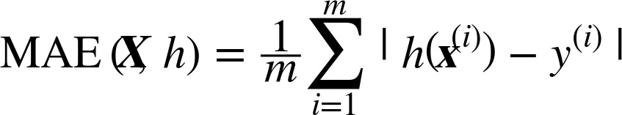
Regularized Linear Models
Mean Absolute Error

Slide 211
Regularized Linear Models
Both RMSE and MAE are ways to measure distances
Between two vectors
Predictor values vector and target values vector
There are various distance measures or norm to calculate distance between two vectors
Manhattan Norm
Euclidean Norm

Slide 212
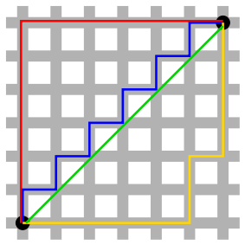
Regularized Linear Models
B
A
Different paths between point A and B

Slide 213
Regularized Linear Models
B
Euclidean Distance
Manhattan Distance
A
Different paths between point A and B
Red, Yellow and Blue paths (If we can only travel along orthogonal city blocks) - Manhattan Distance
Green path - Euclidean Distance

Slide 214
Regularized Linear Models
L1 norm
Computing the sum of absolutes (MAE) corresponds to L1(ℓ₁) norm
Denoted as
∥ · ∥₁
Also called as Manhattan norm

Slide 215
Regularized Linear Models
L2 norm
Computing the root of a sum of squares(RMSE) corresponds to L2(ℓ₂) norm
Denoted as
∥ · ∥₂ or just ∥ · ∥
Also called as Euclidean norm

Slide 216
Regularized Linear Models
ℓ_{k} norm
The ℓ_{k} norm of a vector v containing n elements is defined as
ℓ₀ just gives the cardinality of the vector
i.e., the number of elements
And ℓ∞ gives the maximum absolute value in the vector

Slide 217
Regularized Linear Models
ℓ_{k} norm
The higher the norm index
The more it focuses on large values and
Neglects small ones
This is why the RMSE is
More sensitive to outliers than the MAE
But when outliers are exponentially rare (like in a bell-shaped curve)
The RMSE performs very well and is generally preferred

Slide 218
Regularized Linear Models
L1 vs L2 Regularization
L1 can yield sparse models while L2 doesn't
Sparse models help in feature selection
Which features are important and
Which features are redundant

Slide 219
Regularized Linear Models
Let’s understand Ridge, Lasso and Elastic Net now

Slide 220
Regularized Linear Models
Ridge Regression

Slide 221
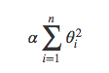
Ridge Regression
Ridge Regression is a regularized version of Linear Regression
A regularization term is added to the cost function
Regularization term

Slide 222
Ridge Regression
Adding a regularization term to cost function
Forces the learning algorithm to not only fit the data
But also keep the model weights as small as possible
Note that
Regularization term should only be added to the cost function during training
Once the model is trained we evaluate the model’s performance using the unregularized performance measure

Slide 223
Ridge Regression
Question
Why add the regularization term only during the training not while evaluating the model performance during testing?

Slide 224
Ridge Regression
Answer
Cost function should have optimization- friendly weights during training
While the performance measure used for testing should be as close as possible to the final objective
This is why we evaluate the model’s performance using the unregularized performance measure

Slide 225
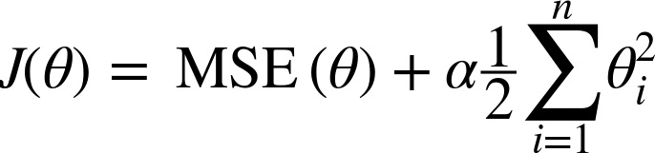
Ridge Regression
Ridge Regression Cost Function
The hyperparameter “𝜶” controls
How much you want to regularize the model
If 𝜶 = 0
Then Ridge Regression is just Linear Regression

Slide 226
Ridge Regression
Ridge Regression Cost Function
Note that the bias term θ₀ is not regularized
As the sum starts at i = 1, not 0
We are just constraining the weights of features hence
Regularization of bias term is not required

Slide 227

Ridge Regression
Ridge Regression Cost Function
If w is the vector of feature weights (θ₁ to θ_{n})
Then the regularization term is equal to
Where ∥ · ∥₂ represents the l₂ (L2) norm of the weight vector

Slide 228
Ridge Regression
Important point
Please make sure to
Scale the data (e.g., using a StandardScaler)
Before performing Ridge Regression
As Ridge Regression is sensitive to the scale of input features

Slide 229
Ridge Regression
Let’s train models using Ridge Regression on some linear data using different 𝜶 value

Slide 230

Ridge Regression
Plain Ridge models, leading to linear predictions

Slide 231
Ridge Regression
Polynomial Regression with Ridge regularization (See the code in notebook)
Data is first expanded using PolynomialFeatures(degree=10)
Then scaled using a StandardScaler
Finally the Ridge models are applied to the resulting features

Slide 232
Ridge Regression
Polynomial Regression with Ridge regularization
Increasing 𝜶 leads to
flatter - less extreme, more reasonable predictions
This reduces the model’s variance but increases its bias

Slide 233
Ridge Regression
Implementing Ridge Regression
Like Linear Regression we can perform Ridge Regression either
By computing a closed-form equation or
By performing Gradient Descent

Slide 234

Ridge Regression
Implementing Ridge Regression - closed-form Solution
Where A is the
n * n identity matrix
except with a 0 in the top-left cell - The bias term

Slide 235

Ridge Regression
Implementing Ridge Regression - closed-form Solution
Identity matrices with ones on the main diagonals and zeros elsewhere

Slide 236
Ridge Regression
Ridge Regression with Scikit-Learn using a closed-form solution
>>> from sklearn.linear_model import Ridge
>>> ridge_reg = Ridge(alpha=1, solver="cholesky", random_state=42)
>>> ridge_reg.fit(X, y)
>>> ridge_reg.predict([[1.5]])
Output-
array([[ 1.55071465]])

Slide 237
Ridge Regression
Ridge Regression with Scikit-Learn using Stochastic Gradient Descent
>>> sgd_reg = SGDRegressor(penalty="l2", random_state=42)
>>> sgd_reg.fit(X, y.ravel())
>>> sgd_reg.predict([[1.5]])
The penalty hyperparameter sets the type of regularization term to use
Specifying "l2" (L2) means
We want SGD to add a regularization term to the cost function
Equal to half the square of the l2 norm of the weight vector

Slide 238
Ridge Regression
Ridge Regression with Scikit-Learn using Stochastic Gradient Descent
>>> sgd_reg = SGDRegressor(penalty="l2", random_state=42)
>>> sgd_reg.fit(X, y.ravel())
>>> sgd_reg.predict([[1.5]])
Output-
array([ 1.13500145])

Slide 239
Regularized Linear Models
Lasso Regression

Slide 240

Lasso Regression
Least Absolute Shrinkage and Selection Operator Regression
Like Ridge regression, a regularization term is added to the cost function
But it uses the L1 norm of the weight vector instead of half the square of the L2 norm
Lasso Regression cost function

Slide 241
Lasso Regression
Let’s train models using Lasso Regression on some linear data using different 𝜶 value
(See the code in notebook)

Slide 242

Lasso Regression
Lasso Regression for Different Values of Alpha
Plain Linear Regression
Polynomial Regression

Slide 243
Lasso Regression
An important characteristic of Lasso Regression
It completely eliminates the weights of the least important features
Sets them to zero

Slide 244
Lasso Regression
Lasso Regression automatically performs feature selection and
Outputs a sparse model
i.e, the model with few nonzero feature weights

Slide 245
Lasso Regression
The dashed green line (with α = 10⁻⁷) in the right plot
Looks quadratic, almost linear
All the weights for the high-degree polynomial features are equal to zero
Notes:
Missing Figure 4-19. Lasso versus Ridge regularization

Slide 246
Lasso Regression
Lasso Regression using Scikit-Learn
>>> from sklearn.linear_model import Lasso
>>> lasso_reg = Lasso(alpha=0.1)
>>> lasso_reg.fit(X, y)
>>> lasso_reg.predict([[1.5]])
Output-
array([ 1.53788174])

Slide 247
Regularized Linear Models
Elastic Net

Slide 248

Elastic Net
Elastic Net is middle ground
Between Ridge Regression and Lasso Regression
The regularization term is a
Simple mix of both Ridge and Lasso’s regularization terms
Elastic Net cost function
Lasso’s regularization term
Ridge regularization term

Slide 249
Elastic Net
When r = 0
Elastic Net is equivalent to Ridge Regression
Elastic Net cost function
When r=0
Ridge Regression cost function

Slide 250
Elastic Net
When r = 1
Elastic Net is equivalent to Lasso Regression
Elastic Net cost function
When r=1
Lasso Regression cost function

Slide 251
Elastic Net
So when should we use Linear Regression, Ridge, Lasso, or Elastic Net?

Slide 252
Elastic Net
Linear Regression, Ridge, Lasso, or Elastic Net
We should avoid plain Linear Regression
Always preferable to have at least
A little bit of regularization
Ridge is a good default
But if we think only few features are useful
We should prefer Lasso or
Elastic Net
As they reduce the useless features’ weights down to zero

Slide 253
Elastic Net
Linear Regression, Ridge, Lasso, or Elastic Net
In general, Elastic Net is preferred over Lasso
Since Lasso may behave erratically
When the number of features
Is greater than the number of training instances or
When several features are strongly correlated

Slide 254
Elastic Net
Implement Elastic Net using Scikit-Learn
>>> from sklearn.linear_model import ElasticNet
>>> # l1_ratio corresponds to the mix ratio r
>>> elastic_net = ElasticNet(alpha=0.1, l1_ratio=0.5, random_state=42)
>>> elastic_net.fit(X, y)
>>> elastic_net.predict([[1.5]])
Output-
array([ 1.54333232])

Slide 255
Regularized Linear Models
Early Stopping

Slide 256
Early Stopping
A different way to
Regularize iterative learning algorithms
Such as Gradient Descent is
To stop training as soon as the
Validation error reaches a minimum
This is called early stopping

Slide 257

Early Stopping
High-degree Polynomial Regression model trained using Batch Gradient Descent
(See the code in the notebook)

Slide 258
Early Stopping
As the epochs increases the algorithm learns and
Its prediction error (RMSE) on the training set goes down and
So does its prediction error on the validation set

Slide 259
Early Stopping
After a while the
Validation error starts increasing
This indicates that the
Model has started to overfit the training data

Slide 260
Early Stopping
Stop at this point
With early stopping
We just stop training as soon as the
Validation error reaches the minimum

Slide 261
Early Stopping
Tip
In previous example of Batch Gradient Descent
The curve was smooth
That is why we could locate the minimum easily
With Stochastic and Mini-batch Gradient Descent
The curves are not so smooth and
It may be hard to know whether
We have reached the minimum or not

Slide 262
Early Stopping
Tip
One solution is to
Stop only after the validation error
Has been above the minimum for some time
Then roll back the model parameters to the point
Where the validation error was at a minimum

Slide 263
Early Stopping
See the code in notebook for basic implementation of early stopping

Slide 264
Training Models
Logistic Regression

Slide 265
Logistic Regression
Logistic Regression is a binary classifier
It is used to
Estimate the probability that
An instance belongs to a particular class

Slide 266
Logistic Regression
Positive and Negative Class
Example
What is the probability that this email is spam?
If the estimated probability is
Greater than 50%
Then the instance belong to that class
Positive class is labeled as “1”
Else it predicts that
Instance does not belongs to that class
Negative class is labeled as “0”

Slide 267
Logistic Regression
Estimating Probabilities

Slide 268
Estimating Probabilities
Just like a Linear Regression model, a Logistic Regression model
Computes the weighted sum of
The input features plus a bias term
Unlike Linear Regression model, a Logistic Regression model, Outputs
0 or 1
the logistic of result

Slide 269

Estimating Probabilities
Logistic Regression Model Estimated Probability
σ -The logistic or Sigmoid function

Slide 270


Estimating Probabilities
Logistic or Sigmoid Function
Outputs a number between 0 and 1

Slide 271

Estimating Probabilities
Logistic Regression Model Estimated Probability
Once the probability p^ (p-hat) is estimated
Make predictions y^ (y-hat) using below equation

Slide 272
Estimating Probabilities
σ(t) < 0.5 when t < 0 and
σ(t) ≥ 0.5 when t ≥ 0
So a Logistic Regression model predicts
1 if θ^{T} · X is positive and
0 if it is negative

Slide 273
Logistic Regression
Training and Cost Function

Slide 274
Training and Cost Function
Let’s understand how to train a Logistic Regression model
The objective of training is to
Set the parameter vector θ so that model estimates
High probabilities for positive instances (y = 1) and
Low probabilities for negative instances (y = 0)

Slide 275

Training and Cost Function
Cost function of a single training instance
Note that in case of classification y can have only two values 0 and 1

Slide 276

Training and Cost Function
c(θ)
c(θ)
c(θ) = -log(p^)
c(θ)= -log(1-p^)

Slide 277
Training and Cost Function
y = -log(p^)
c(θ)
p^
If y = 1 and p^ = 1(both actual and predicted probability are one)
Then Cost = 0

Slide 278
Training and Cost Function
y = -log(p^)
c(θ)
p^
If y = 1 and p^ = 0 (Predicted probability is different from actual value)
As p^ -> 0, cost -> infinity
We penalize learning algorithm by a very large cost

Slide 279
Training and Cost Function
y = -log(1-p^)
c(θ)
p^
If y = 0, p^ = 1 (Predicted probability is different from actual value)
Then cost -> infinity
We penalize learning algorithm by a very large cost

Slide 280
Training and Cost Function
y = -log(1-p^)
c(θ)
p^
If y = 0, p^ = 0 (both actual and predicted probability are zero)
Then cost = 0

Slide 281

Training and Cost Function
Logistics Regression Cost Function

Slide 282
Logistic Regression
Decision Boundaries

Slide 283
Decision Boundaries
Let’s use the iris dataset to illustrate Logistic Regression
This is the famous dataset
That contains the sepal and petal length and width of
150 iris flowers of three different species
Iris-Setosa
Iris-Versicolor and
Iris-Virginica

Slide 284

Decision Boundaries
Flowers of three iris plant species

Slide 285

Decision Boundaries

Slide 286

Decision Boundaries
IRIS Dataset

Slide 287
Decision Boundaries
Let’s look at the dataset
>>> from sklearn import datasets
>>> iris = datasets.load_iris()
>>> list(iris.keys())
Output -
['data', 'target', 'target_names', 'DESCR', 'feature_names']

Slide 288
Decision Boundaries
Let’s look at the dataset
>>> from sklearn import datasets
>>> iris = datasets.load_iris()
>>> list(iris.keys())
Output -
['data', 'target', 'target_names', 'DESCR', 'feature_names']
Let’s look at the keys

Slide 289
Decision Boundaries
Check description of dataset
['data', 'target', 'target_names', 'DESCR', 'feature_names']
>>> print(iris.DESCR)
Check the description in notebook

Slide 290

Decision Boundaries
Check data
['data', 'target', 'target_names', 'DESCR', 'feature_names']
>>> print(iris.data)
Output -
Sepal Width (in cm)
Sepal Length (in cm)
Petal Length (in cm)
Petal Width (in cm)

Slide 291
Decision Boundaries
Check features_names
['data', 'target', 'target_names', 'DESCR', 'feature_names']
>>> print(iris.feature_names)
Output -
['sepal length (cm)', 'sepal width (cm)', 'petal length (cm)', 'petal width (cm)']

Slide 292

Decision Boundaries
Check target
['data', 'target', 'target_names', 'DESCR', 'feature_names']
>>> print(iris.target)
Output -
There are 150 targets with 50 0s, 50 1s and 50 2s
What does 0, 1 and 2 means here?

Slide 293

Decision Boundaries
Check target_names
['data', 'target', 'target_names', 'DESCR', 'feature_names']
>>> print(iris.target_names)
Output -
0
1
2

Slide 294
Decision Boundaries
Now let’s build a classifier to detect the Iris-Virginica type based only on the petal width feature

Slide 295
Decision Boundaries
Train a Logistic Regression model
>>> X = iris["data"][:, 3:] # petal width
>>> y = (iris["target"] == 2).astype(np.int) # 1 if Iris-Virginica, else 0
>>> from sklearn.linear_model import LogisticRegression
>>> log_reg = LogisticRegression(random_state=42)
>>> log_reg.fit(X, y)

Slide 296
Decision Boundaries
Now let’s look at the model’s estimated probabilities
For flowers with petal widths varying from 0 to 3 cm
>>> X_new = np.linspace(0, 3, 1000).reshape(-1, 1)
>>> y_proba = log_reg.predict_proba(X_new)
>>> plt.plot(X_new, y_proba[:, 1], "g-", linewidth=2, label="Iris-Virginica")
>>> plt.plot(X_new, y_proba[:, 0], "b--", linewidth=2, label="Not Iris-Virginica")

Slide 297

Decision Boundaries
Output-
Estimated probabilities and decision boundary

Slide 298
Decision Boundaries
The petal width of Iris-Virginica flowers
Represented by triangles
Ranges from 1.4 cm to 2.5 cm

Slide 299
Decision Boundaries
Other Iris flowers
Represented by Squares
Have a smaller petal width
Ranging from 0.1 cm to 1.8 cm

Slide 300
Decision Boundaries
Notice there is a bit of overlap
How does classifier predicts then?

Slide 301
Decision Boundaries
Above about 2 cm
The classifier is highly confident that the
Flower is an Iris-Virginica
As it outputs a high probability to that class

Slide 302
Decision Boundaries
While below 1(one) cm
The classifier is highly confident that the
Flower is not an Iris-Virginica
As it outputs a high probability for the “Not Iris-Virginica” class

Slide 303
Decision Boundaries
There is a decision boundary at around 1.6 cm
Where both probabilities are equal to 50%

Slide 304
Decision Boundaries
If the petal width is higher than 1.6 cm
The classifier will predict that the flower is an Iris-Virginica
Or else it will predict that it is not

Slide 305
Decision Boundaries
Let’s check the predictions
>>> log_reg.predict([[1.7], [1.5]])
Output-
array([1, 0])

Slide 306
Decision Boundaries
Now let’s build a classifier to detect the Iris-Virginica type based on petal width and length

Slide 307
Decision Boundaries
Now the the Logistic Regression classifier
Estimates the probability that a
New flower is an Iris-Virginica based on
Petal width and
Petal length features
Check out the code in Jupyter notebook

Slide 308

Decision Boundaries
Linear decision boundary

Slide 309
Decision Boundaries
The dashed line represents the points
Where the model estimates a 50% probability
This is the model’s decision boundary

Slide 310
Decision Boundaries
Each parallel line represents the points
Where the model outputs a specific probability
from 15% (bottom left) to 90% (top right)

Slide 311
Decision Boundaries
All the flowers beyond the top-right line
Have an over 90% chance of being Iris-Virginica

Slide 312
Decision Boundaries
Regularization
Like linear models, Logistic Regression models can be regularized
Using L1 or L2 penalties
Scikit-Learn adds an L2 penalty by default

Slide 313
Logistic Regression
Softmax Regression

Slide 314
Softmax Regression
The Logistic Regression model
Can be generalized to support multiple classes
Without having to train and combine multiple binary classifiers
This is called Softmax Regression or Multinomial Logistic Regression
Let’s do a quick hands-on on Softmax Regression before going into theory

Slide 315
Softmax Regression
Let’s classify the iris flowers into all three classes
>>> # Softmax Regression
>>> X = iris["data"][:, (2, 3)] # petal length, petal width
>>> y = iris["target"]
>>> softmax_reg = LogisticRegression(
multi_class="multinomial",
solver="lbfgs",
C=10,
random_state=42
)
>>> softmax_reg.fit(X, y)

Slide 316
Softmax Regression
lbfgs - Broyden–Fletcher–Goldfarb–Shanno (BFGS) algorithm
Is an iterative method for solving unconstrained nonlinear optimization problems
C - Hyperparameter for regularizing L2

Slide 317
Softmax Regression
Predict the type of iris having 5 cm long and 2 cm wide petal
>>> softmax_reg.predict([[5, 2]])
Output -
array([2])
# Iris-Virginica

Slide 318
Softmax Regression
Predict the probability
>>> softmax_reg.predict_proba([[5, 2]])
Output -
array([[6.33134077e-07, 5.75276067e-02, 9.42471760e-01]])
Iris- Versicolor with 5.8% probability
Iris-Virginica (class 2) with 94.2% probability

Slide 319

Softmax Regression
In Softmax Regression
Given an instance x
Softmax model first computes a score s_{k}(x) for each class k
Then applies the softmax function (Discussed in next slide) to the scores
Softmax score for class k
Each class has its own parameter vector θ_{k}

Slide 320
Decision Boundaries
IRIS Dataset

Slide 321

Softmax Function
Softmax Function
Once we have score of every class for the instance x
Then we can estimate the probability p^_{k} using softmax function
p^_{k} - probability that the instance belongs to class k
It computes the exponential of every score
Then normalizes them (dividing by the sum of all the exponentials)

Slide 322
Softmax Function
Softmax Function
K is the number of classes
s(x) is a vector containing the
Scores of each class for the instance x.
σ(s(x))_{k} is the estimated probability that the
Instance x belongs to class k
Given the scores of each class for that instance.

Slide 323
Softmax Function
Softmax function
Calculates the probabilities of each target class
Over all possible target classes
It returns the
Probabilities of each class and
The target class will have the high probability

Slide 324
Softmax Function
Softmax Function Properties
The calculated probabilities will be in the range of 0 to 1
The sum of all the probabilities is equals to 1

Slide 325
Softmax Function
Softmax Function Usages
Used in multiple classification logistic regression model
In building neural networks softmax functions used in different layers

Slide 326

Linear Regression
Normal vs Uniform Distribution Example
Normal distribution
Uniform distribution over the range of [-5, 5]

